Slide 1
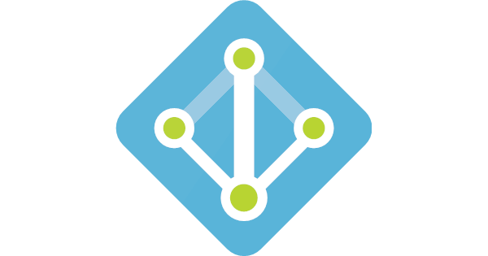


Slide 2
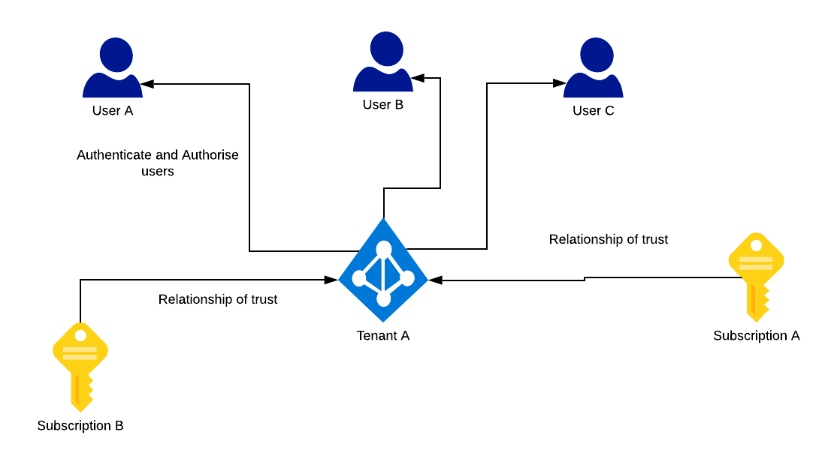
Introduction

Slide 3
What are Security Principals?
User
Any user who has a profile in Azure Active Directory
Group
Multiple users are assigned to a group
Roles can be assigned to groups, thereby impacting the users of that group
Service principal
A security ID for apps
Managed Identity
To help with credential management

Slide 4
Hands-On: Creating User and Group

Slide 5
What is Role-Based Access Control?
RBAC allows to assign permissions to users, groups, and applications
For example
Global Admin can assign the role of Virtual Machine Contributor to Janis within the subscription
This grants Janis the right to create, delete, or modify any virtual machine within the subscription

Slide 6
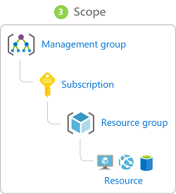
Scope of RBAC

Slide 7
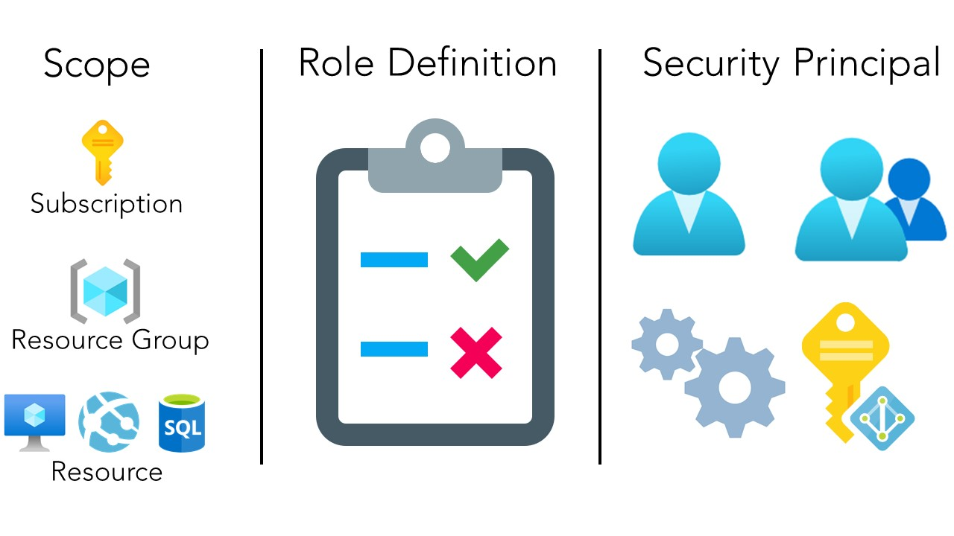
Scope, Role Definition and Security Principal

Slide 8
Azure Built-in Roles
Owner
Has full access including
Contributor
Has same access as owner other than delegation of access.
Reader
Can view existing Azure resources

Slide 9
Hands-On: Assigning a Role to a User

Slide 10
Application Registration, Service Principal

Slide 11
Azure Service Principal
A security identity used by
User-created apps
Services, and
Automation tools
Think of it as a 'user identity' (login and password or certificate) with specific role
It only needs to be able to do specific things, unlike a general user identity
It improves security if you only grant it the minimum permissions level needed to perform its tasks.

Slide 12
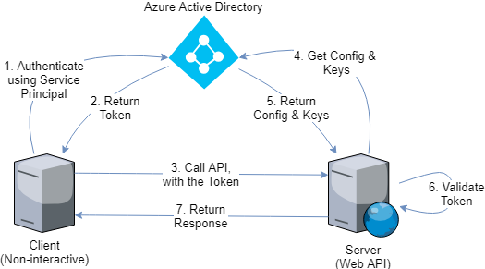
Azure Service Principal

Slide 13


